Slide 1

Numerical Solution
of
Ordinary Differential Equations
Chapter 25
Credit: Prof. Lale Yurttas, Chemical Eng., Texas A&M University

Slide 2
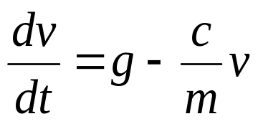
Differential Equations
Differential equations play a fundamental role in engineering. Many physical phenomena are best formulated in terms of their rate of change:
Equations which are composed of an unknown function and its derivatives are called differential equations.
One independent variable ➔ ordinary differential equation (or ODE)
Two or more independent variables ➔ partial diff. equation (or PDE)
A first order equation includes a first derivative as its highest derivative
Second order equation includes second derivative
Higher order equations can be reduced to a system of first order equations, by redefining the variables.
v- dependent variable
t- independent variable

Slide 3

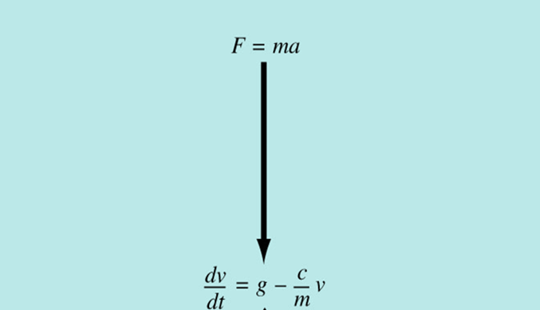
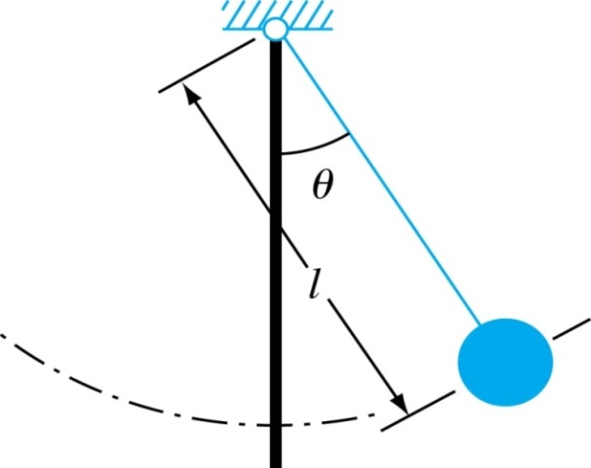
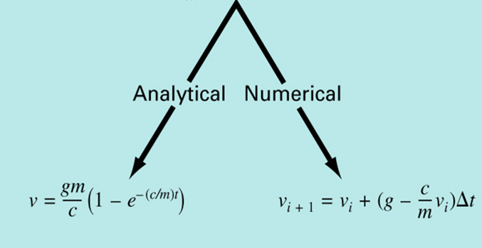
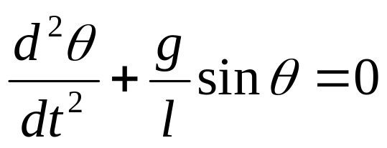
ODEs and Engineering Practice
Swinging pendulum
A second-order
nonlinear ODE.
Falling parachutist problem

Slide 4
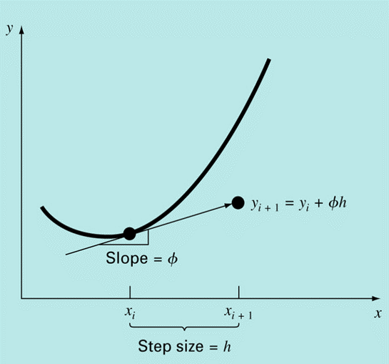
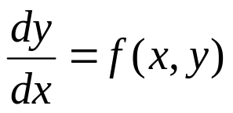
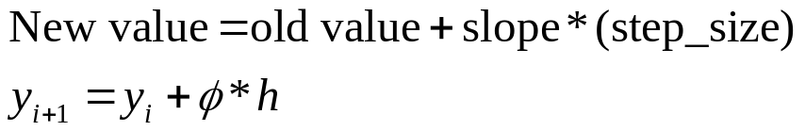
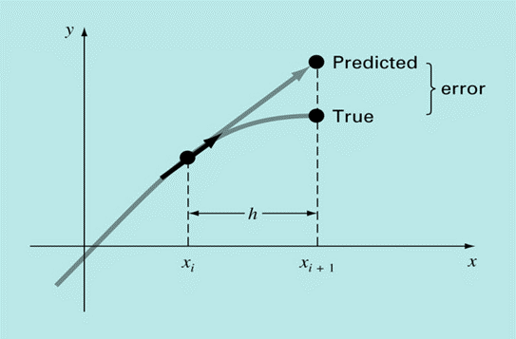
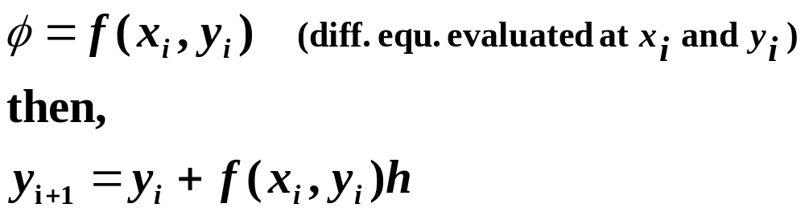
Solving Ordinary Differential Equations (ODEs)
This chapter is devoted to solving ordinary differential equations (ODEs) of the form
Euler’s Method
First derivative provides a direct estimate of the slope at x_{i}:

Slide 5
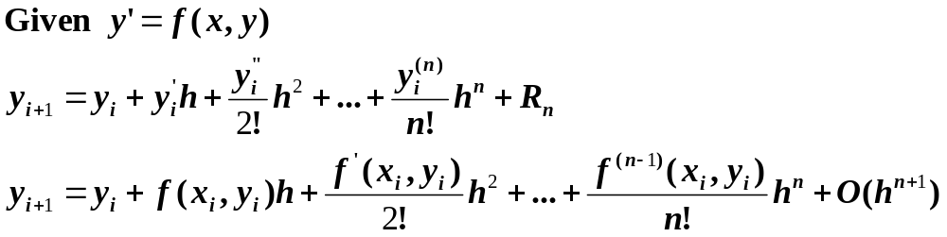
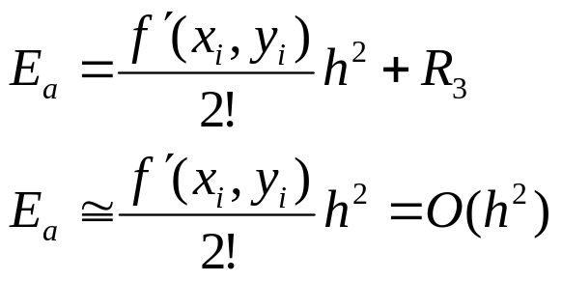
Error Analysis for Euler’s Method
Numerical solutions of ODEs involves two types of error:
  Truncation error
    Local truncation error
    Propagated truncation error
  The sum of the two is the total or global truncation error
  Round-off errors (due to limited digits in representing numbers in a computer)
We can use Taylor series to quantify the local truncation error in Euler’s method.
The error is reduced by 4 times if the step size is halved ➔ O(h²).
In real problems, the derivatives used in the Taylor series are not easy to obtain.
  If the solution to the differential equation is linear, the method will provide error free predictions (2nd derivative is zero for a straight line).
EULER
Local Truncation ERROR

Slide 6
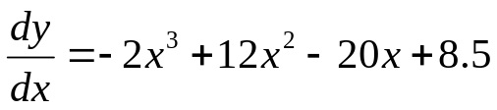
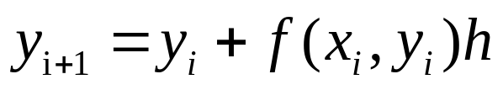
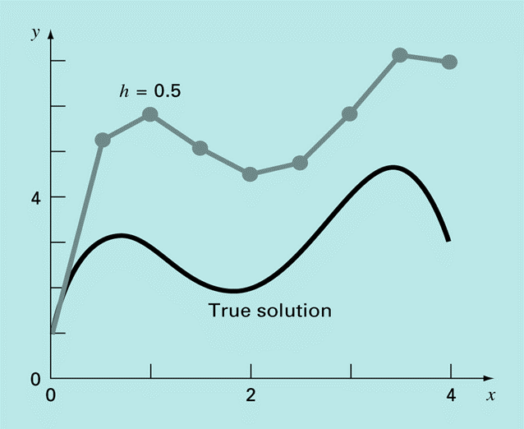
Example: Euler’s Method
Solve numerically :
From x=0 to x=4 with step size h=0.5
initial condition: (x=0 ; y=1)
Exact Solution: y = -0.5x⁴ + 4x³ - 10x² + 8.5x + 1
Numerical
Solution:
y(0.5) = y(0)+f(0, 1)0.5 = 1+8.5*0.5 = 5.25
(true solution at x=0.5 is y(0.5) = 3.22 and ε_{t} = 63%)
y(1) = y(0.5)+f(0.5, 5.25)0.5
= 5.25+[-2(0.5)³+12(0.5)²-20(0.5)+8.5]*0.5
= 5.25+0.625 = 5.875
(true solution at x=1 is y(1) = 3 and ε_{t} = 96%)
y(1.5) = y(1)+f(1, 5.875)0.5 = 5.125
…. ➔➔➔➔
X | y_{euler} | y_{true} | Error Global | Error Local
0 | 1 | 1 | % | %
0.5 | 5.250 | 3.218 | 63.1 | 63.1
1.0 | 5.875 | 3.000 | 95.8 | 28
1.5 | 5.125 | 2.218 | 131.0 | 1.41
2.0 | 4.500 | 2.000 | 125.0 | 20.5

Slide 7
Improvements of Euler’s method
A fundamental source of error in Euler’s method is that the derivative at the beginning of the interval is assumed to apply across the entire interval.
Two simple modifications are available to circumvent this shortcoming:
  Heun’s Method
  The Midpoint (or Improved Polygon) Method

Slide 8
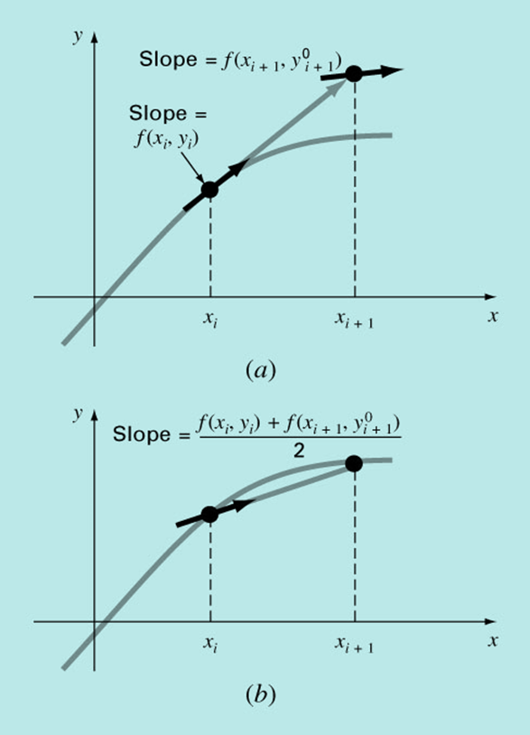
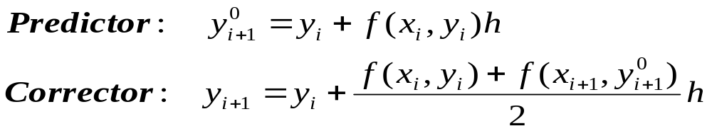
Heun’s method
To improve the estimate of the slope, determine two derivatives for the interval:
    At the initial point
    At the end point
The two derivatives are then averaged to obtain an improved estimate of the slope for the entire interval.

Slide 9
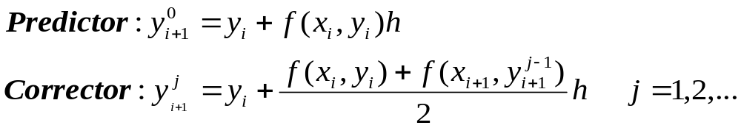
Heun’s method (improved)
Original Huen’s:
Note that the corrector can be iterated to improve the accuracy of y_{i+1}.
However, it does not necessarily converge on the true answer but will converge on an estimate with a small error.
Example 25.5 from Textbook

Slide 10
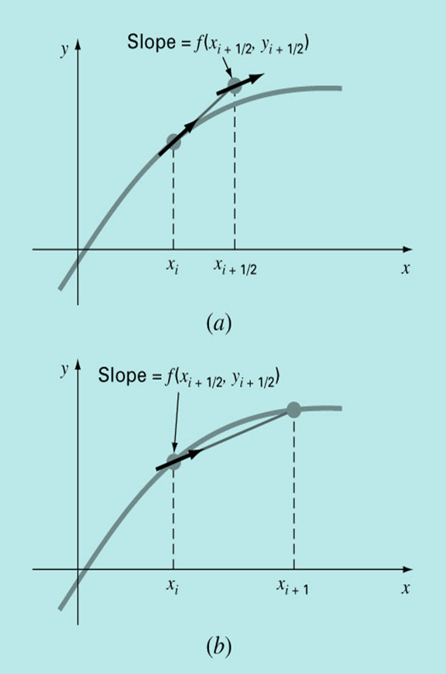
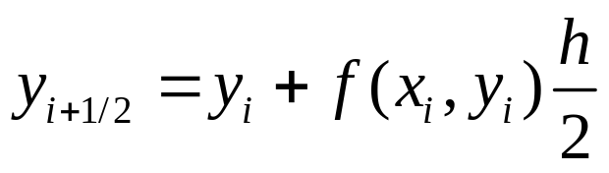
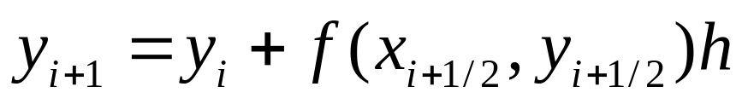
The Midpoint (or Improved Polygon) Method
Uses Euler’s method to predict a value of y using the slope value at the midpoint of the interval:

Slide 11
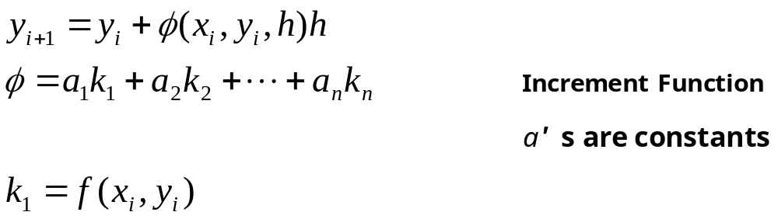
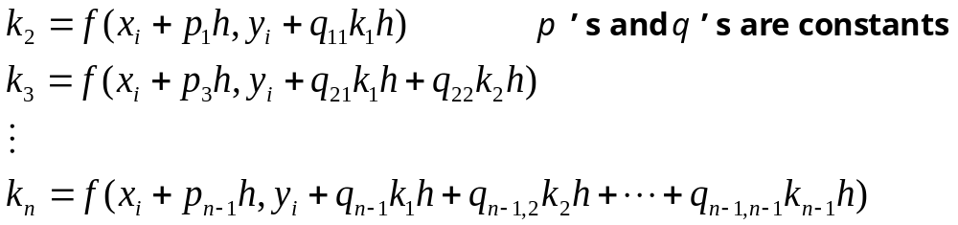
Runge-Kutta Methods (RK)
Runge-Kutta methods achieve the accuracy of a Taylor series approach without requiring the calculation of higher derivatives.

Slide 12
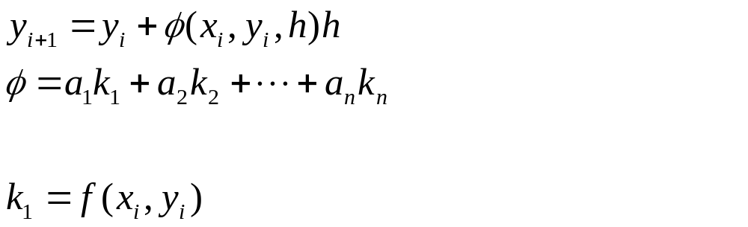
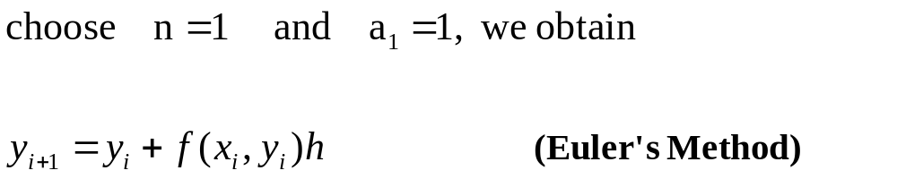
Runge-Kutta Methods (cont.)
Various types of RK methods can be devised by employing different number of terms in the increment function as specified by n.
First order RK method with n=1 and a₁ =1 is in fact Euler’s method.

Slide 13
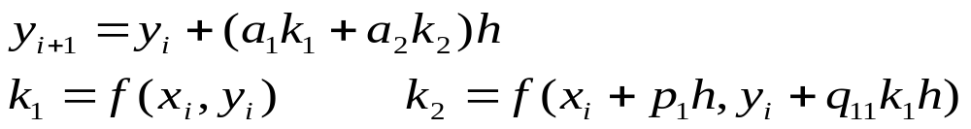
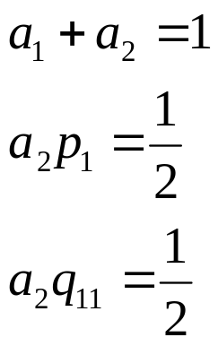
Runge-Kutta Methods (cont.)
Second-order Runga-Kutta Methods:
Values of a₁, a₂, p₁, and q₁₁ are evaluated by setting the above equation equal to a Taylor series expansion to the second order term. This way, three equations can be derived to evaluate the four unknown constants (See Box 25.1 for this derivation).
A value is assumed for one of the unknowns to solve for the other three.

Slide 14
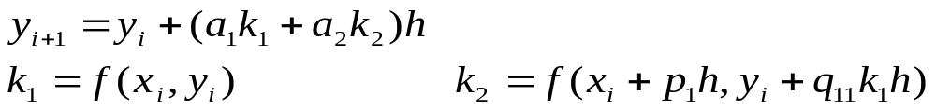
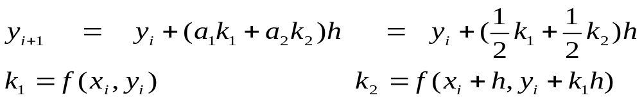
Because we can choose an infinite number of values for a₂,
there are an infinite number of second-order RK methods.
Three of the most commonly used methods are:
  Huen’s Method with a Single Corrector (a₂=1/2)
  The Midpoint Method (a₂=1)
  Ralston’s Method (a₂=2/3)
  Huen’s Method (a₂ = 1/2) ➔ a₁ = 1/2 p₁ = 1 q₁₁ = 1

Slide 15
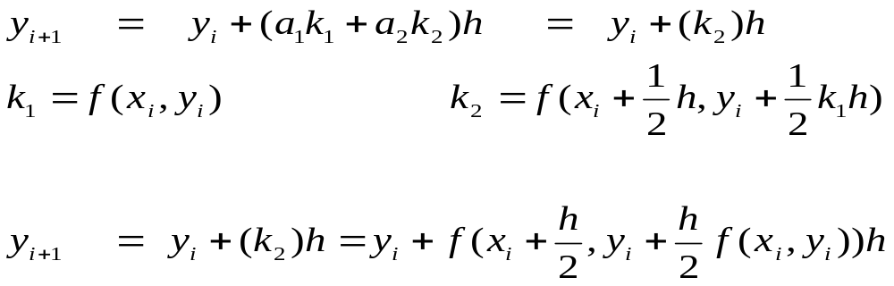
  The Midpoint Method (a₂ = 1)
  ➔➔➔ a₁ = 0 p₁ = 1/2 q₁₁ = 1/2

Slide 16
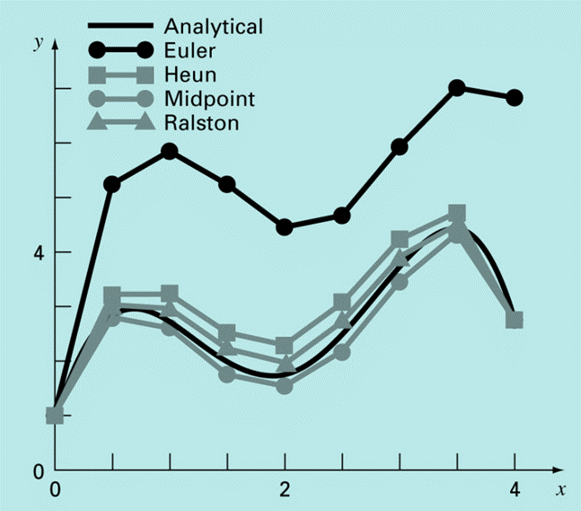
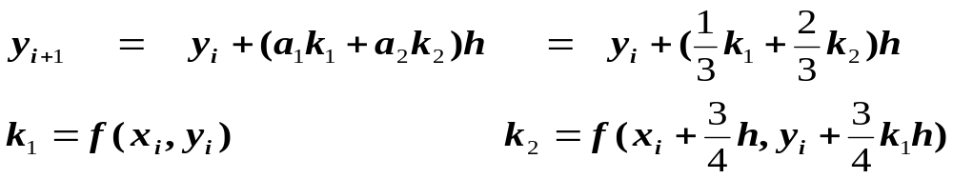
Three most commonly used methods:
  Huen Method with a Single Corrector (a₂=1/2)
  The Midpoint Method (a₂=1)
  Ralston’s Method (a₂=2/3)
Comparison of Various
Second-Order RK Methods
  Ralston’s Method (a₂=2/3)

Slide 17
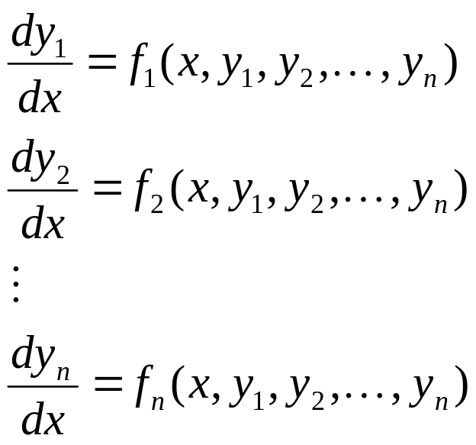
Systems of Equations
Many practical problems in engineering and science require the solution of a system of simultaneous ordinary differential equations (ODEs) rather than a single equation:
Solution requires that n initial conditions be known at the starting value of x.
i.e. (x₀, y₁(x₀), y₂(x₀), …, y_{n}(x₀))
At iteration i, n values (y₁(x_{i}), y₂(x_{i}), …, y_{n}(x_{i})) are computed.

